Slide 1



Early prediction of in-hospital mortality using routinely collected electronic health record data: an analysis of the MIMIC-III database
Angela Coloma Escudero, Clara Podaru Savu, Albert Garcia Bernat
Notes:
Individual oral presentation
Maximum 5 minutes

Slide 2
Introduction
The Challenge: Predicting mortality is a central task in critical care medicine.
Benefits: Early risk detection optimizes clinical decisions and resource allocation.
The Problem: Traditional scores (SOFA, APACHE) can lack flexibility in modern ICU settings.
The Data: MIMIC-III enables large-scale, reproducible research using real EHR data.
Model Choice: Interpretable models are essential for clinical trust and adoption.
Aim of the study
To develop and evaluate an interpretable model for in-hospital mortality
Using routinely collected variables from the first 24 hours of ICU admission

Slide 3
Materials and methods
Data source
Retrospective study using the MIMIC-III database
De-identified ICU data from Beth Israel Deaconess Medical Center (2001–2012)
Includes demographics, vital signs, laboratory data, diagnoses, and outcomes
Database access granted after ethics training and data use agreement
SQL-based data extraction (documented in Supplementary Notebook S1)
Study population
Adult ICU patients
Only first ICU admission per patient included
Patients with missing mortality outcome excluded
Retrospective cohort design
Variables collected during the first 24 hours of ICU admission

Slide 4
Materials and methods
Outcome and predictors
Primary outcome: in-hospital mortality
Predictors:
Demographics: age, gender
Vital signs: heart rate, respiratory rate, mean arterial pressure, temperature, SpO₂
Laboratory variables: lactate, creatinine, white blood cell count
Mean values used when multiple measurements were available within 24h
Variables retained in original scale for clinical interpretability
Data preprocessing
Ages >89 years recoded to 91 years (MIMIC-III guidelines)
Outliers handled using Winsorization (1st–99th percentiles)
Extreme values capped to preserve physiological signal while improving model stability

Slide 5
Statistical analysis
Baseline Characteristics
Summarized using descriptive statistics.
Continuous variables: mean ± SD
Categorical variables: counts and percentages
Collinearity assessed with Pearson correlation matrix
All variables showed low correlation (r < 0.35) → suitable for multivariate modeling
Model Evaluation & Reproducibility
Data split: 70% training, 30% testing (comparable outcome distribution).
Performance metrics:
Area Under the ROC Curve (AUC)
Confusion matrix: sensitivity, specificity, NPV
Modeling Strategy
In-hospital mortality: 11% → marked class imbalance.
Weighted logistic regression applied
Higher weight assigned to non-survivors
Prioritizes sensitivity for early high-risk patient identification

Slide 6
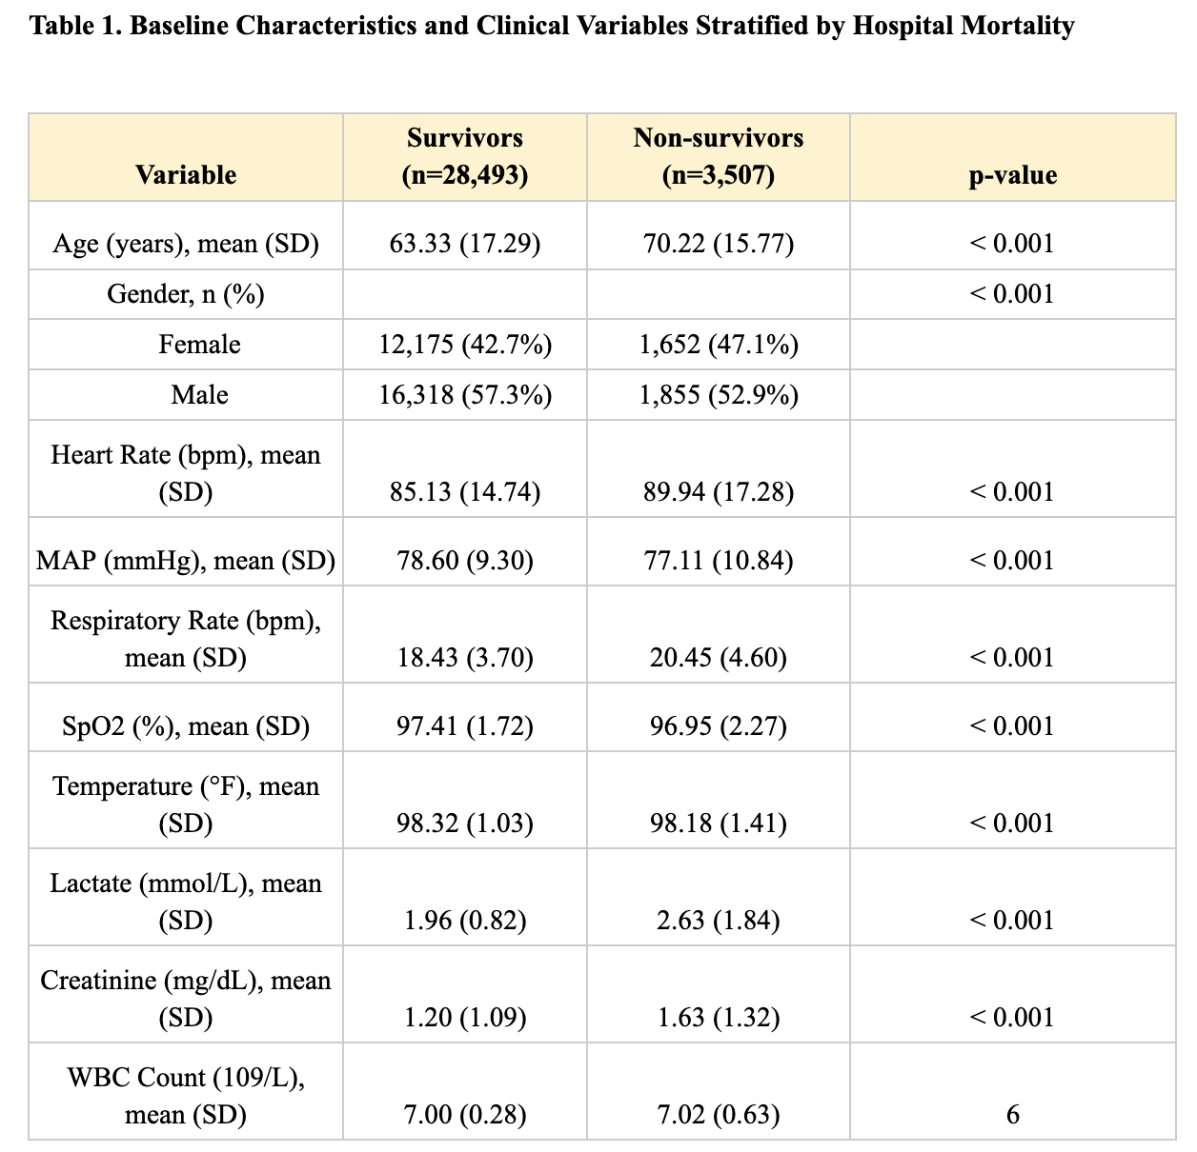
Results
Cohort overview
Total sample: 32,000 ICU admissions (first ICU stay per patient).
In-hospital mortality: 10.96% (3,507 deaths).
Independent test set: 9,599 patients, (1,052 deaths out of it).
Key differences at ICU admissions Compared with survivors, non-survivors presented a markedly worse early clinical profile:
Demographics: Older age and higher proportion of females.
Vital signs: ↑ Heart Rate and ↓ MAP within first 24h.
Biomarkers: Significantly ↑ Lactate and ↑ Creatinine.
Indicates early circulatory and renal dysfunction
Data quality considerations
High Variability: Respiratory rate and SpO₂ particularly among survivors
EHR Nature: Reflects outliers and noise typical of retrospective data.

Slide 7
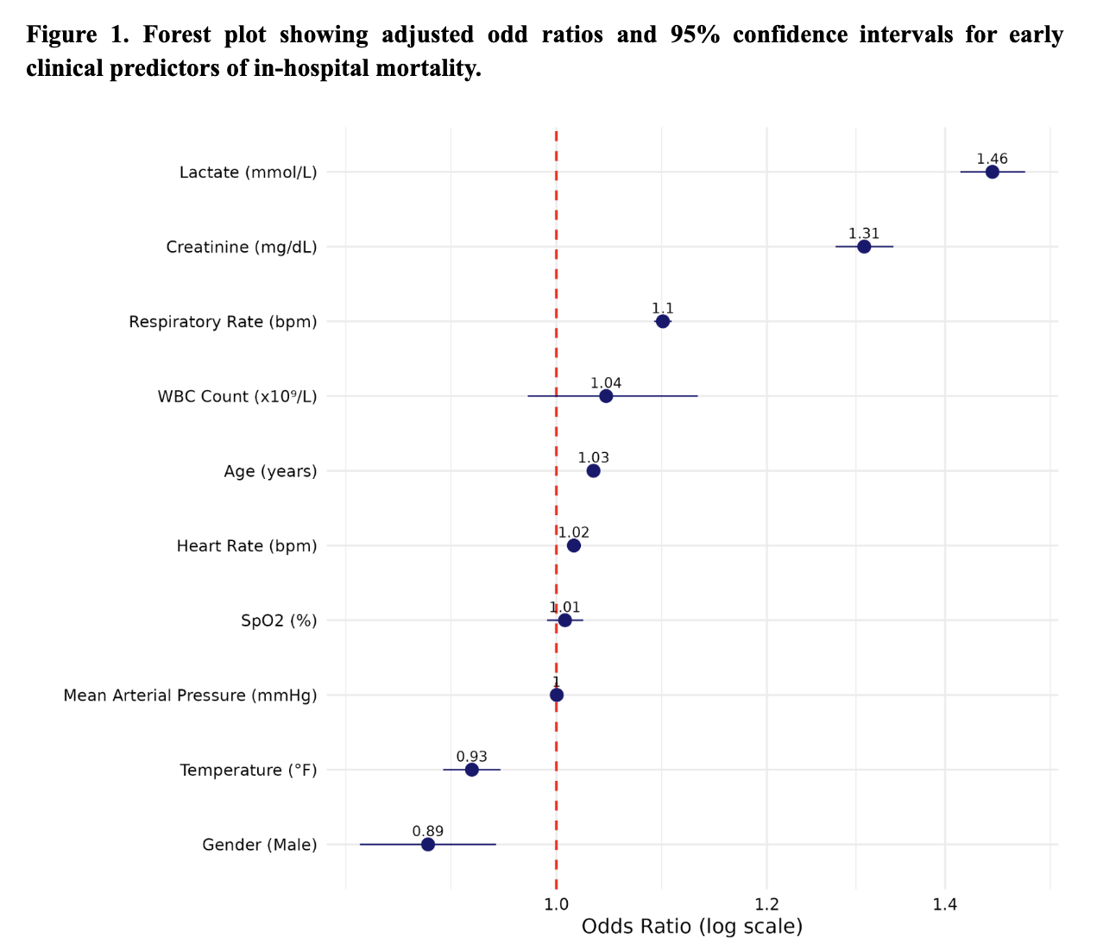
Results
Multivariate Logistic Regression
Critical Risk Factors
Lactate: Strongest independent predictor (metabolic dysfunction)
Creatinine: Key marker of early renal impairment.
Physiological trends associated with higher risk:
↑ Age
↑ Heart Rate
↑ Respiratory Rate
Protective Factors
Male sex
Higher body temperature (lower odds of mortality)
Non-Significant Variables
Mean Arterial Pressure (MAP)
SpO2
White Blood Cell (WBC) count.

Slide 8
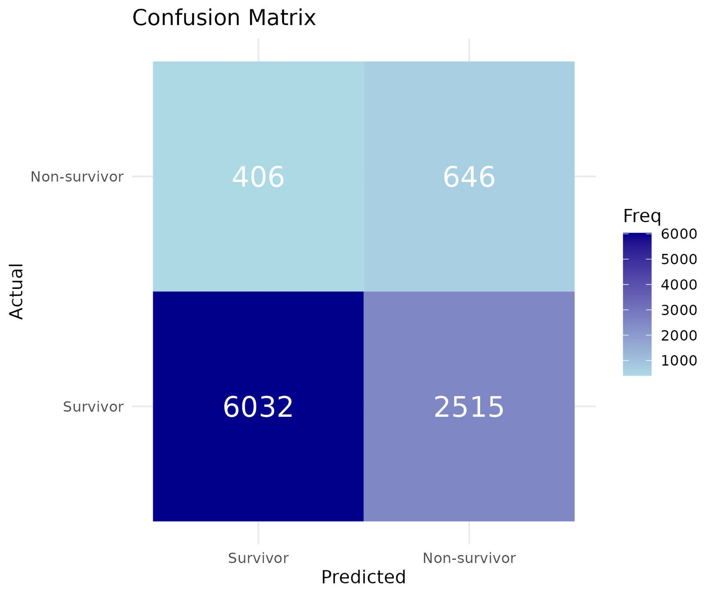
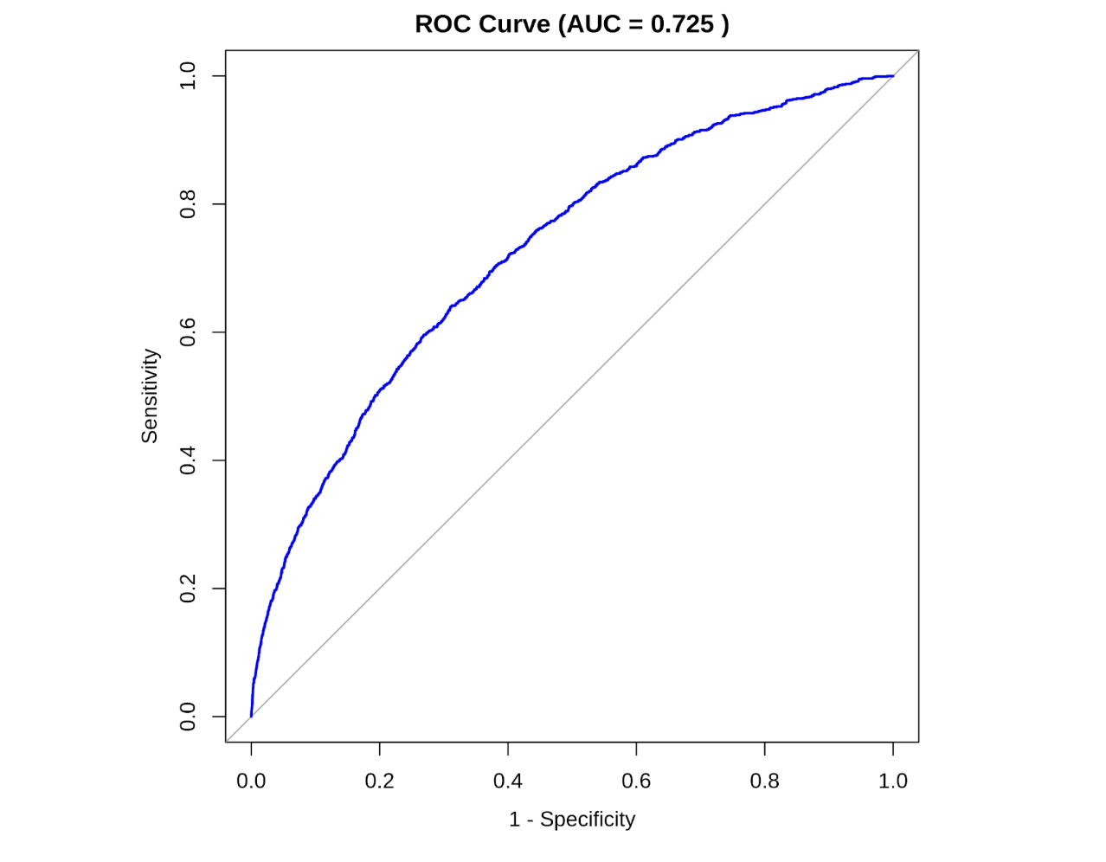
Results
Model performance (n = 9,599)
ROC Cruve: AUC 0.73 (Good discrimination).
Confusion Matrix: 93.7% NPV | 61.4% Sensitivity.
Strategy: Weighed model to minimize False Negatives.
Safety Goal: Prioritizes detection of high-risk patients.

Slide 9
Conclusions
Limitations
Single-center: MIMIC-III data (retrospective).
Data Quality: EHR noise (missing values/outliers).
Outcome: In-hospital vs. ICU-specific mortality.
Validation: External cohort validation required.
Conclusion
Predictors: Lactate (1.46), Creatinine (1.31), and Age.
Metrics: AUC 0.73 | 61% Sens. | 94% NPV.
Impact: Reliable early-warning tool for ICU risk stratification.

